Slide 1

DIVINE GRACE COLLEGE OF ARTS, SCIENCE AND TECHNOLOGY
(DGCAST) — GAROUA | GEOGRAPHY DEPARTMENT
UPPER SIXTH ARTS — ENVIRONMENT AND DEVELOPMENT — LESSON 4
Climatic Change
Mr KAMDEM EMMANUEL
Geography Teacher — PLEG
Academic Year 2026 / 2027
Notes:
Good morning, class. Today we study Lesson 4: Climatic Change.

Slide 2
GEOGRAPHY — UPPER SIXTH ARTS
CLASS INFO
Class, Chapter & Duration
Class | Upper Sixth Arts
Chapter | Module 7: Understanding and managing contemporary environmental and development issues
Duration | 2 periods (2 × 50 minutes)
2026 / 2027
DGCAST GAROUA — GEOGRAPHY DEPARTMENT
Mr KAMDEM E. | 2

Slide 3
GEOGRAPHY — UPPER SIXTH ARTS
IDENTIFICATION
Lesson Identification
Topic | Contemporary Environmental Issues
Sub-topic | Climate Change
Lesson | Lesson 4: Climatic Change
Notions / Concepts | Climate change, greenhouse gases, ice core, El Niño, Milankovitch cycles.
Syllabus focus | Meaning; evidence; natural and human causes.
Competence | Learners are able to explain the evidence and causes of climate change.
2026 / 2027
DGCAST GAROUA — GEOGRAPHY DEPARTMENT
Mr KAMDEM E. | 3

Slide 4
GEOGRAPHY — UPPER SIXTH ARTS
OBJECTIVES
Learning Objectives
By the end of the lesson, the learner should be able to:
Define climatic change.
Describe the evidence of climate change.
Explain its natural and human causes.
2026 / 2027
DGCAST GAROUA — GEOGRAPHY DEPARTMENT
Mr KAMDEM E. | 4

Slide 5
GEOGRAPHY — UPPER SIXTH ARTS
RECALL
Recall
Climate is the average weather over a long time.
Burning fuels releases carbon dioxide.
2026 / 2027
DGCAST GAROUA — GEOGRAPHY DEPARTMENT
Mr KAMDEM E. | 5

Slide 6
GEOGRAPHY — UPPER SIXTH ARTS
REAL-LIFE SITUATION
Real-Life Situation
Old farmers in the North say the rains now start later and stop earlier than when they were young. Scientists also show that glaciers are melting on mountains around the world.
2026 / 2027
DGCAST GAROUA — GEOGRAPHY DEPARTMENT
Mr KAMDEM E. | 6
Notes:
Read the situation slowly, twice.

Slide 7
GEOGRAPHY — UPPER SIXTH ARTS
REAL-LIFE SITUATION
Situation — Question 1
What is the problem in the situation?
2026 / 2027
DGCAST GAROUA — GEOGRAPHY DEPARTMENT
Mr KAMDEM E. | 7

Slide 8
GEOGRAPHY — UPPER SIXTH ARTS
REAL-LIFE SITUATION
Answer
The climate is changing.
2026 / 2027
DGCAST GAROUA — GEOGRAPHY DEPARTMENT
Mr KAMDEM E. | 8

Slide 9
GEOGRAPHY — UPPER SIXTH ARTS
REAL-LIFE SITUATION
Situation — Question 2
Give one piece of evidence in the situation.
2026 / 2027
DGCAST GAROUA — GEOGRAPHY DEPARTMENT
Mr KAMDEM E. | 9

Slide 10
GEOGRAPHY — UPPER SIXTH ARTS
REAL-LIFE SITUATION
Answer
Melting glaciers (or changing rains).
2026 / 2027
DGCAST GAROUA — GEOGRAPHY DEPARTMENT
Mr KAMDEM E. | 10

Slide 11
GEOGRAPHY — UPPER SIXTH ARTS
REAL-LIFE SITUATION
Situation — Question 3
Is climate change natural or human?
2026 / 2027
DGCAST GAROUA — GEOGRAPHY DEPARTMENT
Mr KAMDEM E. | 11

Slide 12
GEOGRAPHY — UPPER SIXTH ARTS
REAL-LIFE SITUATION
Possible Answer
Both, but today it is mainly caused by people.
2026 / 2027
DGCAST GAROUA — GEOGRAPHY DEPARTMENT
Mr KAMDEM E. | 12

Slide 13
GEOGRAPHY — UPPER SIXTH ARTS
JUSTIFICATION
Justification of the Lesson
This lesson helps us to understand the changes in our climate.
2026 / 2027
DGCAST GAROUA — GEOGRAPHY DEPARTMENT
Mr KAMDEM E. | 13

Slide 14
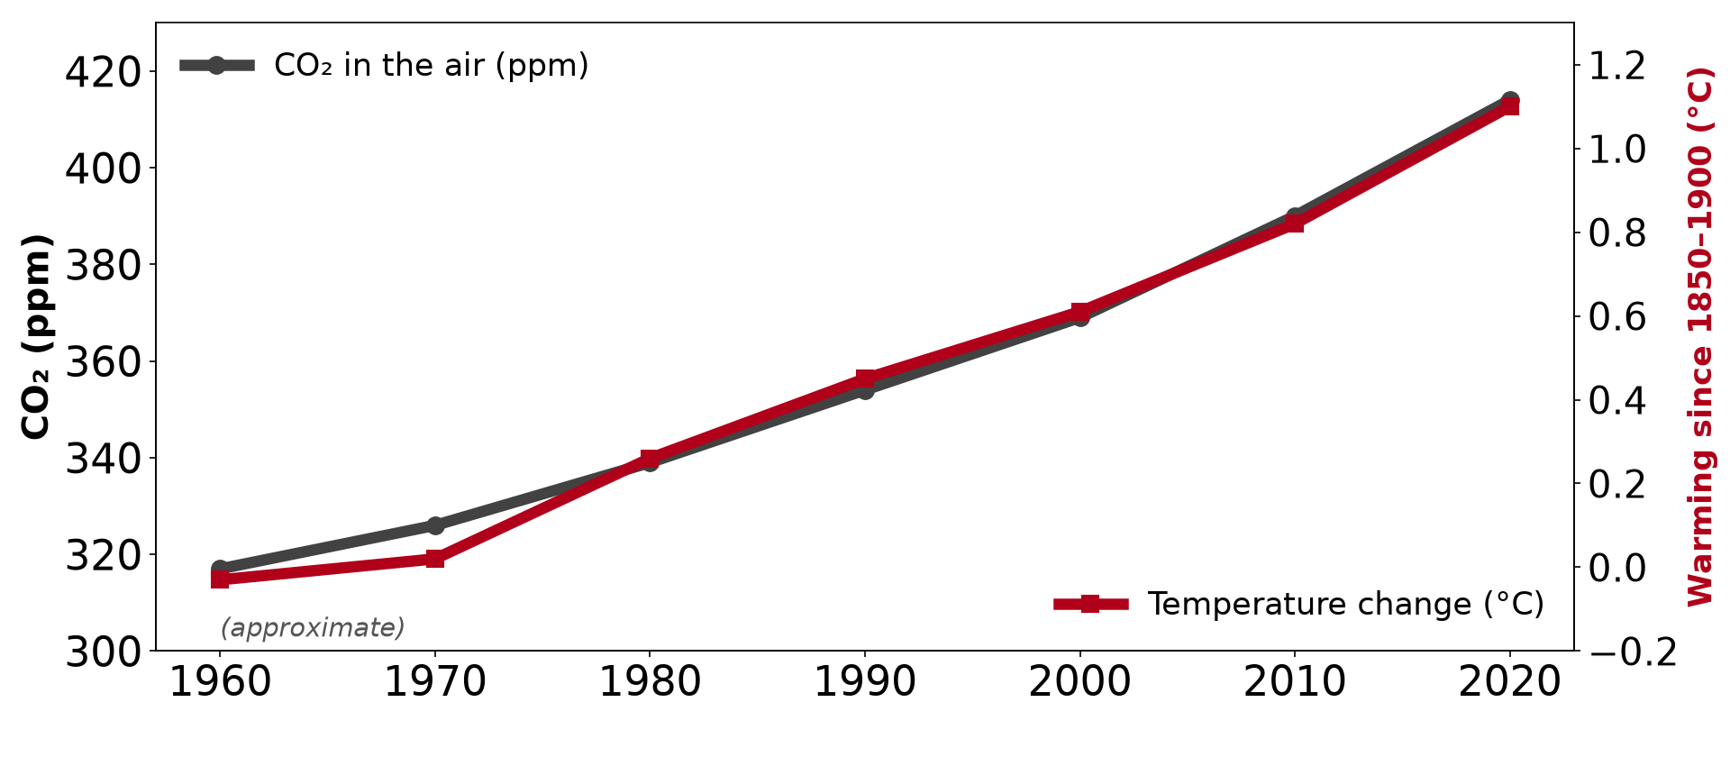
GEOGRAPHY — UPPER SIXTH ARTS
I. MEANING
Activity 1
CO₂ and world temperature (approximate).
2026 / 2027
DGCAST GAROUA — GEOGRAPHY DEPARTMENT
Mr KAMDEM E. | 14
Notes:
Without the projector: read the graph.

Slide 15
GEOGRAPHY — UPPER SIXTH ARTS
I. MEANING
Activity 1: Question
What happened to CO₂ and temperature since 1960?
2026 / 2027
DGCAST GAROUA — GEOGRAPHY DEPARTMENT
Mr KAMDEM E. | 15

Slide 16
GEOGRAPHY — UPPER SIXTH ARTS
I. MEANING
Answer
Both rose steadily: CO₂ from about 317 to 414 ppm and temperature by about 1 °C.
2026 / 2027
DGCAST GAROUA — GEOGRAPHY DEPARTMENT
Mr KAMDEM E. | 16

Slide 17
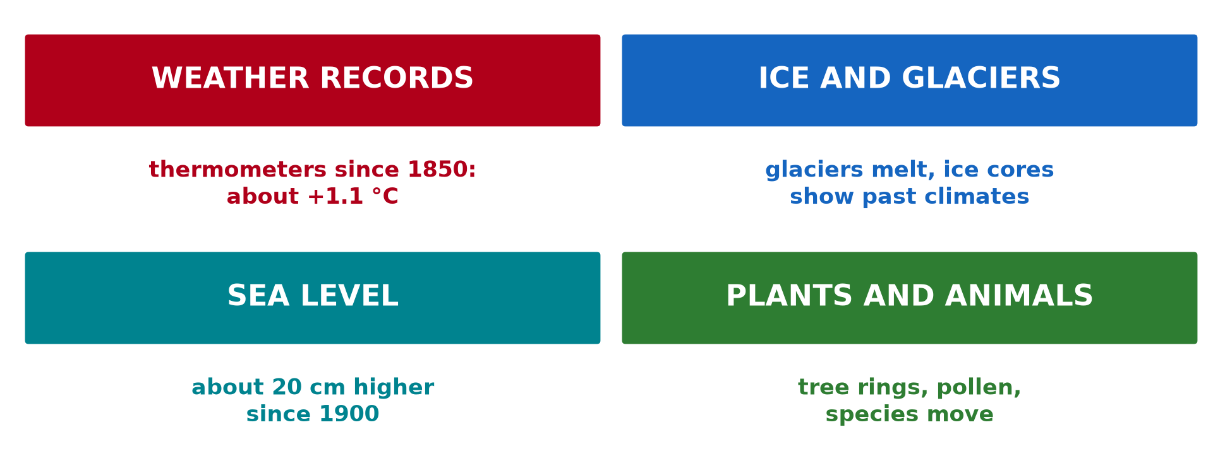
GEOGRAPHY — UPPER SIXTH ARTS
II. EVIDENCE
Activity 2
Evidence of climate change.
2026 / 2027
DGCAST GAROUA — GEOGRAPHY DEPARTMENT
Mr KAMDEM E. | 17
Notes:
Without the projector: list evidence.

Slide 18
GEOGRAPHY — UPPER SIXTH ARTS
II. EVIDENCE
Activity 2: Question
Give three pieces of evidence of climate change.
2026 / 2027
DGCAST GAROUA — GEOGRAPHY DEPARTMENT
Mr KAMDEM E. | 18

Slide 19
GEOGRAPHY — UPPER SIXTH ARTS
II. EVIDENCE
Answer
Weather records, melting glaciers and rising sea level.
2026 / 2027
DGCAST GAROUA — GEOGRAPHY DEPARTMENT
Mr KAMDEM E. | 19

Slide 20
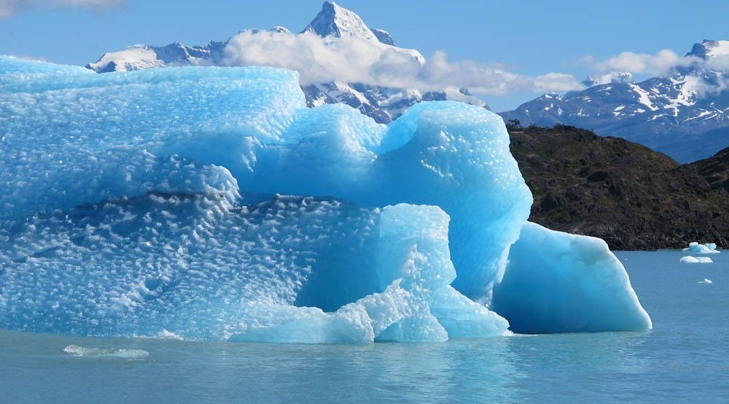
GEOGRAPHY — UPPER SIXTH ARTS
II. EVIDENCE
Activity 3
Melting ice.
2026 / 2027
DGCAST GAROUA — GEOGRAPHY DEPARTMENT
Mr KAMDEM E. | 20
Notes:
Without the projector: discuss melting ice.

Slide 21
GEOGRAPHY — UPPER SIXTH ARTS
II. EVIDENCE
Activity 3: Question
How does melting ice show climate change?
2026 / 2027
DGCAST GAROUA — GEOGRAPHY DEPARTMENT
Mr KAMDEM E. | 21

Slide 22
GEOGRAPHY — UPPER SIXTH ARTS
II. EVIDENCE
Answer
Ice melts because the air and sea are warmer.
2026 / 2027
DGCAST GAROUA — GEOGRAPHY DEPARTMENT
Mr KAMDEM E. | 22

Slide 23
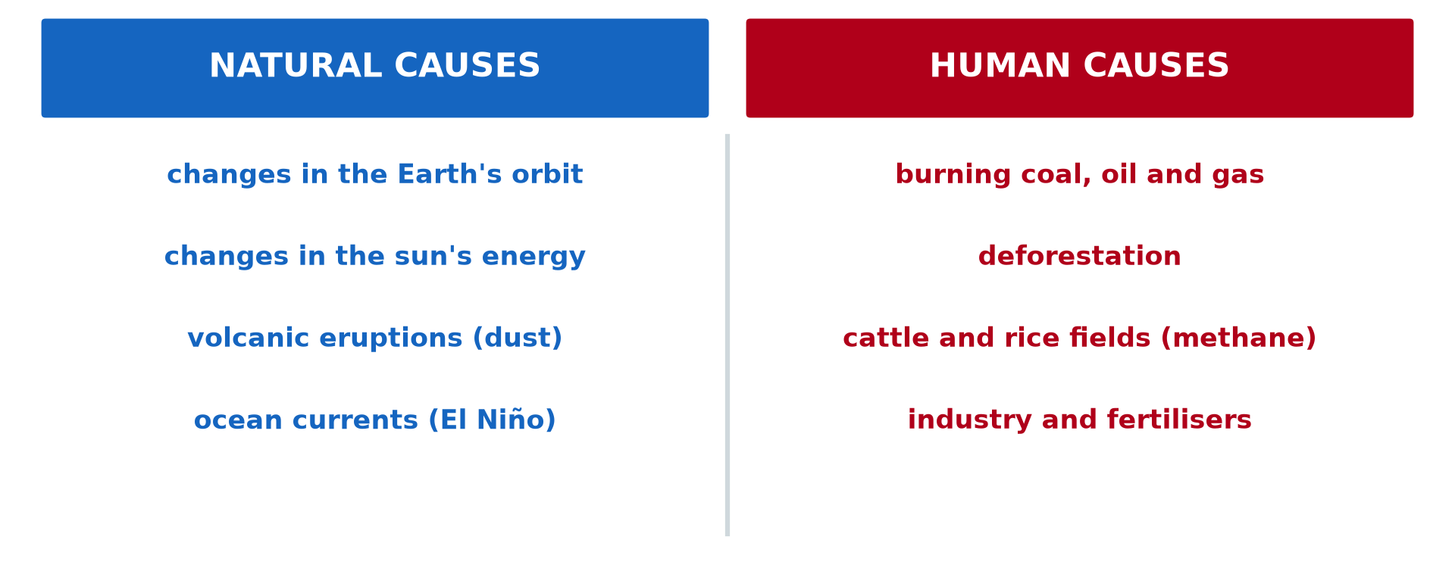
GEOGRAPHY — UPPER SIXTH ARTS
III. NATURAL CAUSES
Activity 4
Natural and human causes.
2026 / 2027
DGCAST GAROUA — GEOGRAPHY DEPARTMENT
Mr KAMDEM E. | 23
Notes:
Without the projector: read the left column.

Slide 24
GEOGRAPHY — UPPER SIXTH ARTS
III. NATURAL CAUSES
Activity 4: Question
Give two natural causes of climate change.
2026 / 2027
DGCAST GAROUA — GEOGRAPHY DEPARTMENT
Mr KAMDEM E. | 24

Slide 25
GEOGRAPHY — UPPER SIXTH ARTS
III. NATURAL CAUSES
Answer
Changes in the Earth's orbit and volcanic eruptions (also the sun and El Niño).
2026 / 2027
DGCAST GAROUA — GEOGRAPHY DEPARTMENT
Mr KAMDEM E. | 25

Slide 26
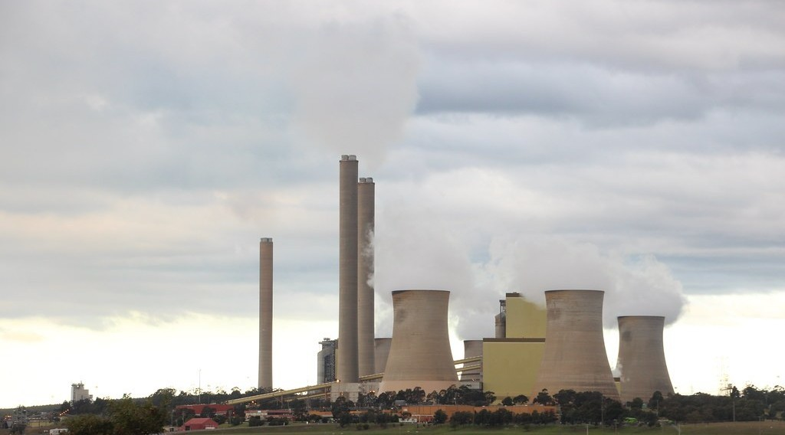
GEOGRAPHY — UPPER SIXTH ARTS
III. HUMAN CAUSES
Activity 5
A coal power station.
2026 / 2027
DGCAST GAROUA — GEOGRAPHY DEPARTMENT
Mr KAMDEM E. | 26
Notes:
Without the projector: discuss fuels we burn.

Slide 27
GEOGRAPHY — UPPER SIXTH ARTS
III. HUMAN CAUSES
Activity 5: Question
How do power stations change the climate?
2026 / 2027
DGCAST GAROUA — GEOGRAPHY DEPARTMENT
Mr KAMDEM E. | 27

Slide 28
GEOGRAPHY — UPPER SIXTH ARTS
III. HUMAN CAUSES
Answer
Burning coal releases CO₂, a greenhouse gas that traps heat.
2026 / 2027
DGCAST GAROUA — GEOGRAPHY DEPARTMENT
Mr KAMDEM E. | 28

Slide 29
GEOGRAPHY — UPPER SIXTH ARTS
BOARD SUMMARY
Climatic Change
Topic: Contemporary Environmental Issues
Sub-topic: Climate Change
Lesson 4: Climatic Change
2026 / 2027
DGCAST GAROUA — GEOGRAPHY DEPARTMENT
Mr KAMDEM E. | 29
Notes:
Learners copy the board summary now. Give them enough time for each slide.

Slide 30
GEOGRAPHY — UPPER SIXTH ARTS
BOARD SUMMARY
I. Definitions
Climatic change: It is a long-term change in the average climate of a place or of the world.
Greenhouse gases: They are gases like CO₂ and methane that trap heat in the atmosphere.
2026 / 2027
DGCAST GAROUA — GEOGRAPHY DEPARTMENT
Mr KAMDEM E. | 30

Slide 31
GEOGRAPHY — UPPER SIXTH ARTS
BOARD SUMMARY
II. Evidence (1/2)
A. Records: Thermometer records show about 1.1 °C of warming since 1850. Rainfall patterns are changing.
B. Ice and sea: Glaciers and ice sheets are melting and sea level is rising. Ice cores show past climates.
C. Nature: Tree rings, pollen and fossils show past changes. Plants and animals now move to cooler places.
2026 / 2027
DGCAST GAROUA — GEOGRAPHY DEPARTMENT
Mr KAMDEM E. | 31

Slide 32
GEOGRAPHY — UPPER SIXTH ARTS
BOARD SUMMARY
II. Evidence (2/2)
Copy the evidence.
2026 / 2027
DGCAST GAROUA — GEOGRAPHY DEPARTMENT
Mr KAMDEM E. | 32

Slide 33
GEOGRAPHY — UPPER SIXTH ARTS
BOARD SUMMARY
III. Causes
A. Natural causes: Changes in the Earth's orbit and the sun's energy change climate over long periods. Volcanic dust and El Niño cause short changes.
B. Human causes: Burning coal, oil and gas and deforestation add greenhouse gases. Cattle, rice fields and fertilisers add methane and nitrous oxide.
2026 / 2027
DGCAST GAROUA — GEOGRAPHY DEPARTMENT
Mr KAMDEM E. | 33

Slide 34
GEOGRAPHY — UPPER SIXTH ARTS
FORMATIVE EVALUATION
Formative Evaluation 1
Give two pieces of evidence of climate change.
2026 / 2027
DGCAST GAROUA — GEOGRAPHY DEPARTMENT
Mr KAMDEM E. | 34

Slide 35
GEOGRAPHY — UPPER SIXTH ARTS
FORMATIVE EVALUATION
Expected Answer
Rising temperatures and melting glaciers.
2026 / 2027
DGCAST GAROUA — GEOGRAPHY DEPARTMENT
Mr KAMDEM E. | 35

Slide 36
GEOGRAPHY — UPPER SIXTH ARTS
FORMATIVE EVALUATION
Formative Evaluation 2
Give two natural and two human causes.
2026 / 2027
DGCAST GAROUA — GEOGRAPHY DEPARTMENT
Mr KAMDEM E. | 36

Slide 37
GEOGRAPHY — UPPER SIXTH ARTS
FORMATIVE EVALUATION
Expected Answer
Natural: volcanoes, orbit changes. Human: burning fuels, deforestation.
2026 / 2027
DGCAST GAROUA — GEOGRAPHY DEPARTMENT
Mr KAMDEM E. | 37

Slide 38
GEOGRAPHY — UPPER SIXTH ARTS
REMEDIATION
Remediation
Fill in the blanks:
CO₂ and methane are ______ gases.
Ice ______ show past climates.
Warming since 1850 is about ______ °C.
2026 / 2027
DGCAST GAROUA — GEOGRAPHY DEPARTMENT
Mr KAMDEM E. | 38
Notes:
Answers: 1. greenhouse 2. cores 3. 1.1

Slide 39
GEOGRAPHY — UPPER SIXTH ARTS
HOMEWORK
Homework
Ask two elders how the seasons have changed and write their answers.
This prepares Lesson 5: Global Warming.
2026 / 2027
DGCAST GAROUA — GEOGRAPHY DEPARTMENT
Mr KAMDEM E. | 39
Notes:
This homework prepares the next lesson.

Slide 40
GEOGRAPHY — UPPER SIXTH ARTS
BILINGUAL GAME
Bilingual Game (Jeu Bilingue)
English | Français
Climate change | Le changement climatique
Evidence | La preuve
Glacier | Le glacier
Greenhouse gas | Le gaz à effet de serre
Volcano | Le volcan
Sea level | Le niveau de la mer
2026 / 2027
DGCAST GAROUA — GEOGRAPHY DEPARTMENT
Mr KAMDEM E. | 40
Notes:
Say the English word; learners give the French word, then the reverse.

Slide 41
GEOGRAPHY — UPPER SIXTH ARTS
LOGBOOK
Official Logbook (1/2)
Module / Topic | Contemporary Environmental Issues
Lesson Title | Lesson 4: Climatic Change
Expected Learning Outcomes | Define climatic change. Describe the evidence of climate change. Explain its natural and human causes.
Competence | Learners are able to explain the evidence and causes of climate change.
2026 / 2027
DGCAST GAROUA — GEOGRAPHY DEPARTMENT
Mr KAMDEM E. | 41

Slide 42
GEOGRAPHY — UPPER SIXTH ARTS
LOGBOOK
Official Logbook (2/2)
Matter Taught | I. Definitions: Climatic change, Greenhouse gases; II. Evidence: Records, Ice and sea, Nature; III. Causes: Natural causes, Human causes.
Evaluation | Formative evaluation (3 questions) and remediation exercise.
Homework | Ask two elders how the seasons have changed and write their answers.
Enrolment / Present / Absent | ____ / ____ / ____
Achievement | To be completed by the teacher after the lesson.
2026 / 2027
DGCAST GAROUA — GEOGRAPHY DEPARTMENT
Mr KAMDEM E. | 42

Slide 43
GEOGRAPHY — UPPER SIXTH ARTS
TEACHER'S NOTE
Teacher's Note
Timing: Set-up, recall 8 min | Situation 8 min | 5 activities 30 min | Board summary (copying) 30 min | Evaluation, remediation 10 min | Homework, logbook 9 min | Spare 5 min
2026 / 2027
DGCAST GAROUA — GEOGRAPHY DEPARTMENT
Mr KAMDEM E. | 43

Slide 44
GEOGRAPHY — UPPER SIXTH ARTS
REFERENCES
References
National Geography Syllabus, Sixth Forms (Lower & Upper Sixth), MINESEC/IGE/IP-SS, August 2019 — Module 7 (Environment and Development).
Photo, Activity 3: “Glaciers and Sea Level Rise” by NASA Goddard Photo and Video, CC BY 2.0, via nasa (https://www.flickr.com/photos/24662369@N07/8742463970)
Photo, Activity 5: “Loy Yang coal power station” by John Englart (Takver), CC BY-SA 2.0, via Flickr (https://www.flickr.com/photos/81043308@N00/18269071871)
Diagrams and animations: drawn for this lesson (DGCAST Geography Department).
2026 / 2027
DGCAST GAROUA — GEOGRAPHY DEPARTMENT
Mr KAMDEM E. | 44

